Slide 1
Capstone Project Final
CHINESE RESTAURANTS IN NEW YORK CITY

Slide 2
1 Introduction: Business Problem
New York is one of the largest city in the North America and the most populated city in the United States. New York City is a metropolitan area with more than 8 million people .The chinese cuisine is on top food interests in New York not only for residents but also for tourists. The main objective is to answer to the next questions:
-Which neigborhoods have the best chinese restaurants?
-Which is the best chinese restaurant in New York(Tips,Likes,Rating)?
-Which areas are best for living if one prefers chinese cuisine?

Slide 3
2.DATA
The data used for this project is gathered from different sources:
-an unprocessed New York data was downloaded in JSON data format:https://cocl.us/new_york_dataset containing neighborhoods and boroughs, latitudes, and longitudes;
- Foursquare API as location data provider, used to retrieve data about chinese restaurants in different neighborhoods, ratings, tips: https://developer.foursquare.com/docs

Slide 4
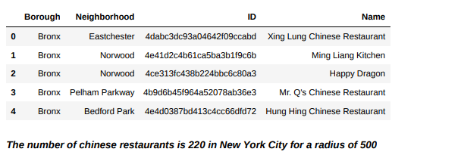
3.METHODOLOGY
Followed the next steps:
I.Import New York City Data containing list of Boroughs,Neighbourhoods along with their lati tude and longitude from https://cocl.us/new_york_dataset.
II.Based on latitude and longitude, we are searching for restaurants for each Neighborhood via Foursquare API
III.Filter out only Chinese Restaurants.

Slide 5
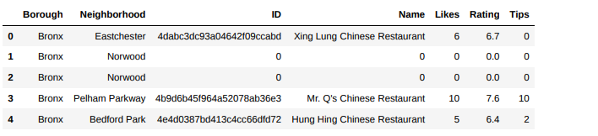
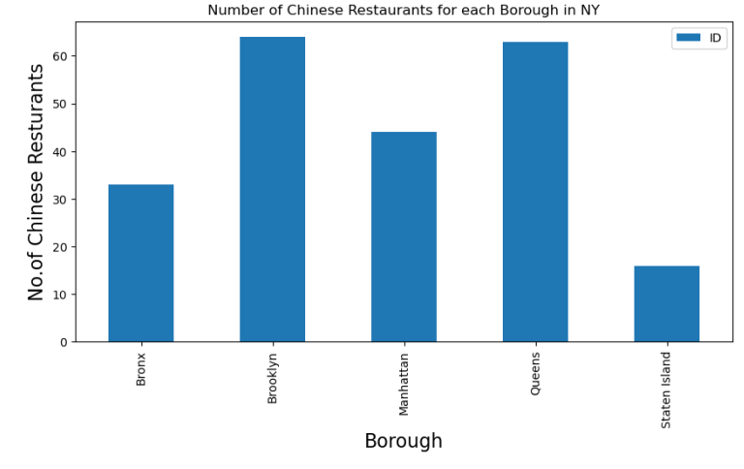
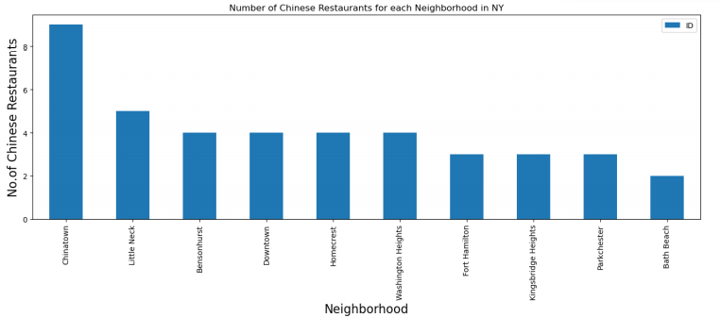
IV. Next we retrieve information - Ratings, Likes, Tips for each Chinise Restaurant, again by using Foursquare API.
V. Perform analysis on the data obtained

Slide 6
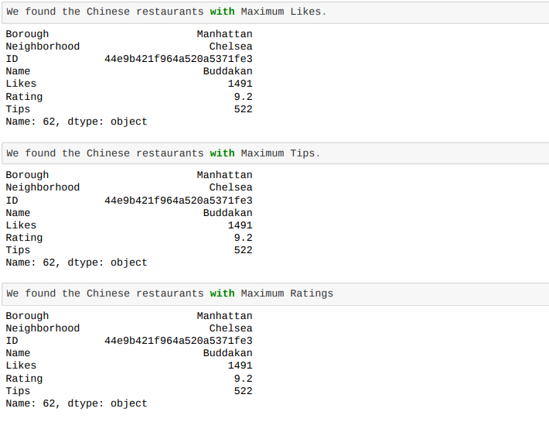

Slide 7
RESULTS
We answered to the initial questions:
Which neigborhoods have the best chinese restaurants? Chelsea,Flatiron, East Village are some of the best Neighborhoods with Chinese Restaurants
Which is the best Chinese restaurant in NYC?
The best chinese restaurant in New York : Buddakan- Chelsea-
Manhattan (Rating-9.2), (Likes-1491),(Likes-1491),(Tips522).
Which areas are best for living if one prefers chinese cuisine? Manhattan is the suitable place to stay if one prefers Chinese cuisine since the average rating of Restaurants in Manhattan is the highest (8.0).

Slide 8
CONCLUSIONS
In this project I performed an analysis on Chinese Restaurants in New York City with the help of visualizations such as bar graphs and maps using Foursquare API in this way I discovered some useful information from the data.

